Slide 1


Integrating Life With Cognitive Services
Eldert Grootenboer
Cloud Solution Architect

Slide 2


@egrootenboer
Eldert Grootenboer
Cloud Solution Architect
Microsoft Azure MVP
SME IoT
Blogger
Published Author
International Speaker
Global Integration Bootcamp
Azure IoT Community
TechNet / MSDN / GitHub
Boat enthusiast

Slide 3
Cognition
The mental action or process of acquiring knowledge and understanding through thought, experience, and the senses
Notes:
So what is Cognition?
Read the quote

Slide 4
What are Cognitive Services?
Cognitive services are a set of APIs that are designed to democratize artificial intelligence by enabling systems to see, hear, speak, understand and interpret our needs using natural methods of communication.
“A picture of Satya Nadella happy”
Image of person
Emotional readings
“x% sure that this person is [highest emotion]”
This is about a person

Slide 5
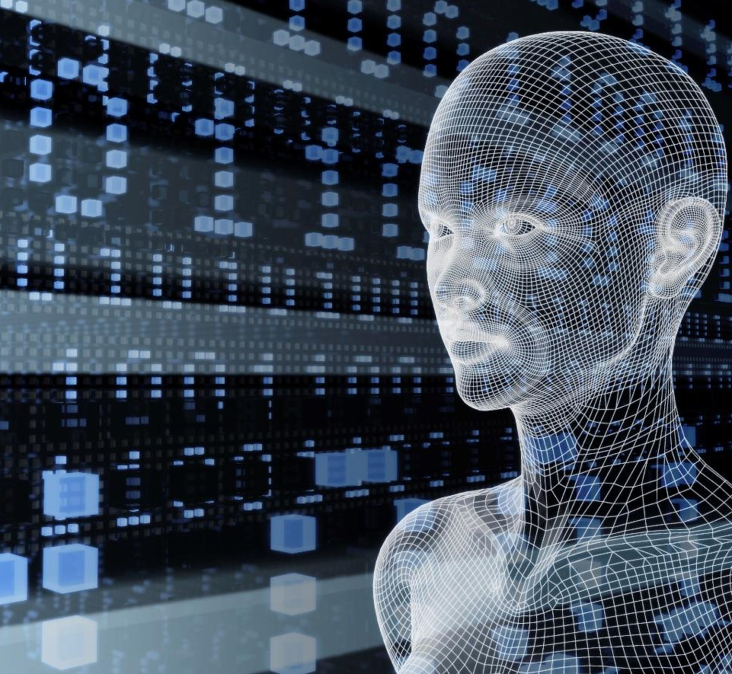
Vision
From faces to feelings, allow your apps to understand images and video
Microsoft Cognitive Services
Give your apps a human side
Speech
Hear and speak to your users by filtering noise, identifying speakers, and understanding intent
Language
Process text and learn how to recognize what users want
Knowledge
Tap into rich knowledge amassed from the web, academia, or your own data
Search
Access billions of web pages, images, videos, and news with the power of Bing APIs

Slide 6
Vision
Computer Vision API
Face API
Emotion API
Video API
Distill actionable information from images
Detect, identify, analyze, organize, and tag faces in photos
Personalize experiences with emotion recognition
Analyze, edit, and process videos within your app

Slide 7
Speech
Vision
Bing Speech API
Speaker Recognition API
Custom Recognition Intelligent Service
Convert speech to text and back again, and understand its intent
Give your app the ability to know who's talking
Fine-tune speech recognition for anyone, anywhere

Slide 8




Speech
Language
Bing Spell Check API
Web Language Model API
Linguistic Analysis API
Language Understanding Intelligent Service
Text Analytics API
Detect and correct spelling mistakes within your app
Leverage the power of language models trained on web-scale data
Easily parse complex text with language analysis
Teach your apps to understand commands from your users
Detect sentiment, key phrases, topics, and language from your text

Slide 9

Language
Knowledge
Academic Knowledge API
Knowledge Exploration Service
Entity Linking Service
Recommendations API
Explore relationships among academic papers, journals, and authors
Add interactive search over structured data to your project
Contextually extend knowledge of people, locations, and events
Provide personalized product recommendations for your customers

Slide 10
Search
Knowledge
Bing Web Search API
Bing Autosuggest API
Bing Image Search API
Bing Video Search API
Bing News Search API
Connect powerful search to your apps
Give your app intelligent autosuggest options for searches
Bring advanced image and metadata search to your app
Trending videos, detailed metadata, and rich results
Link your users to robust and timely news searches

Slide 11
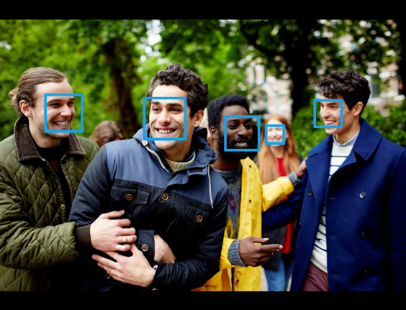
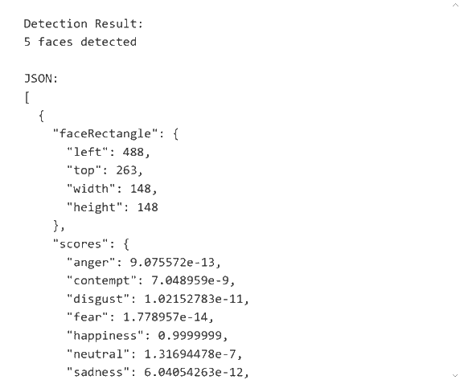
REST/JSON-based Services

Slide 12







Bot Framework
What?
Tools for building REST Web Sites
Services to enrich
Mechanisms for receive events
Data to debug and analyze
Customer’s
Business Logic & Data
Bot Connector
Why?
Implements standard protocols
Modeling conversations is hard. Tools help!
UI across multiple canvases is hard. Cards rock!
Language Understanding is hard
Common and well understood patterns
C#
BOT BUILDER
Bot Controls
Skype
Bing
Web Chat
Goals
Start Simple. Add Complexity. No dead-ends.
Bot adapts to the user, based on context
Composable and intelligent controls to manage complexity
LUIS
Form Filling
QnA
Skype for Business
Cortana
Direct Line
Query over database via Azure Search
3rd Party

Slide 13
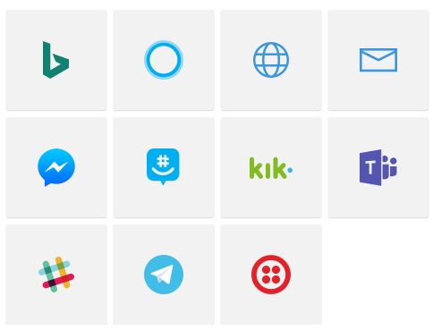
Channels

Slide 14
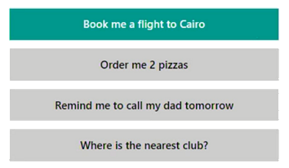
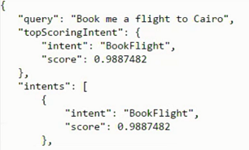

LUIS
Notes:
Customs
Caterpillar die service contract aanbied op schepen

Slide 15
FormFlow
public string NameOfVessel;
[Numeric(1000000, 9999999)]
[Prompt("Please enter your {&}")]
public int OfficialVesselNumber;
[Pattern(@"^(?:\+\d{1,3}|0\d{1,3}|00\d{1,2})?(?:\s?\(\d+\))?(?:[-\/\s.]|\d)+$")]
public string PhoneNumber;
[Numeric(2, 20)]
[Prompt("Please enter the {&}")]
public int NumberOfPeopleOnBoard;
public Cargo? PreviousCargo;
public static IForm<ShipRegistrationDialog> BuildForm()
{
return new FormBuilder<ShipRegistrationDialog>().Message("Welcome to Rotterdam TankTerminals").OnCompletion(StartStoreRegistration).Build();
}

Slide 16
Dialog
[Serializable]
public class EchoDialog : IDialog<object>
{
public async Task StartAsync(IDialogContext context)
{
context.Wait(MessageReceivedAsync);
}
public async Task MessageReceivedAsync(IDialogContext context, IAwaitable<IMessageActivity> argument)
{
var message = await argument;
await context.PostAsync("You said: " + message.Text);
context.Wait(MessageReceivedAsync);
}
}

Slide 17
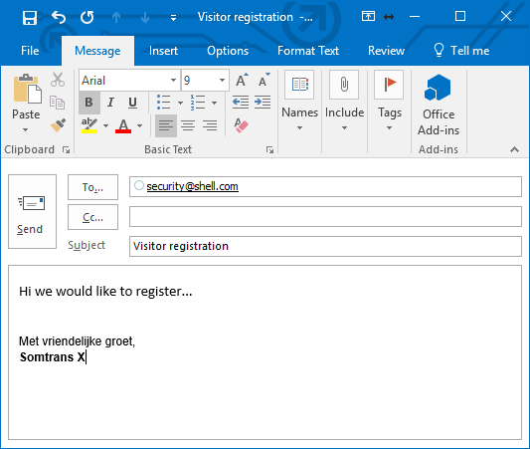
Scenario

Slide 18

Registration Bot

Slide 19
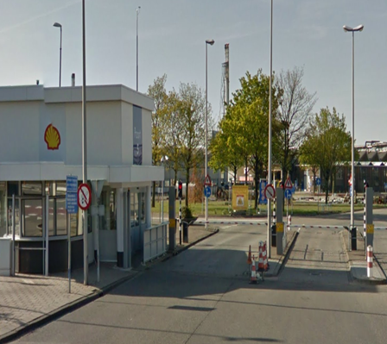
Scenario

Slide 20

License Plate Recognition

Slide 21
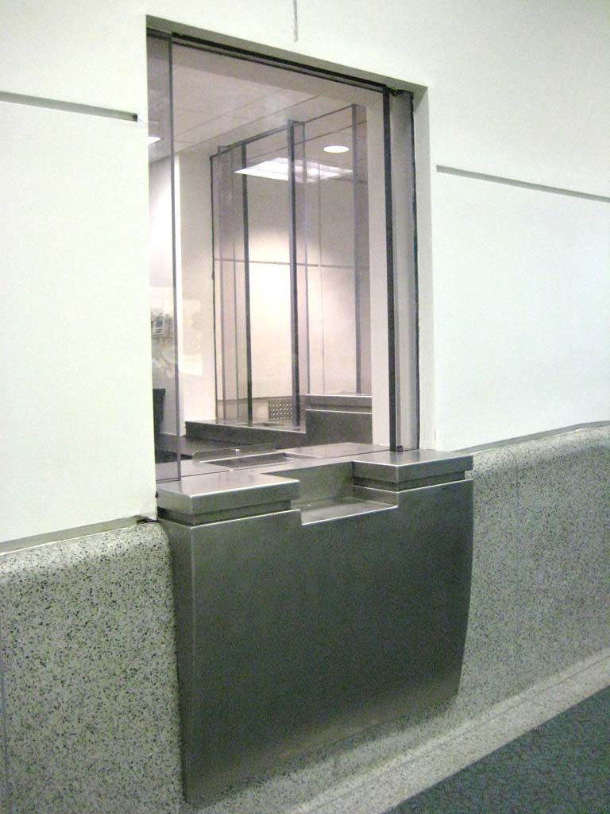
Scenario

Slide 22
Check Known Person

Slide 23

Scenario

Slide 24
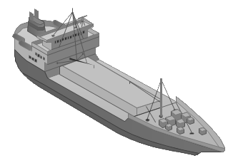

Check Person On Deck

Slide 25
Key Takeaways
Easy
Very easy to do complex work
Extensive
Many options and keeps expanding
Integrate
Use results from cognitive services in your processes
IoT
Big opportunities within IoT space

Slide 26
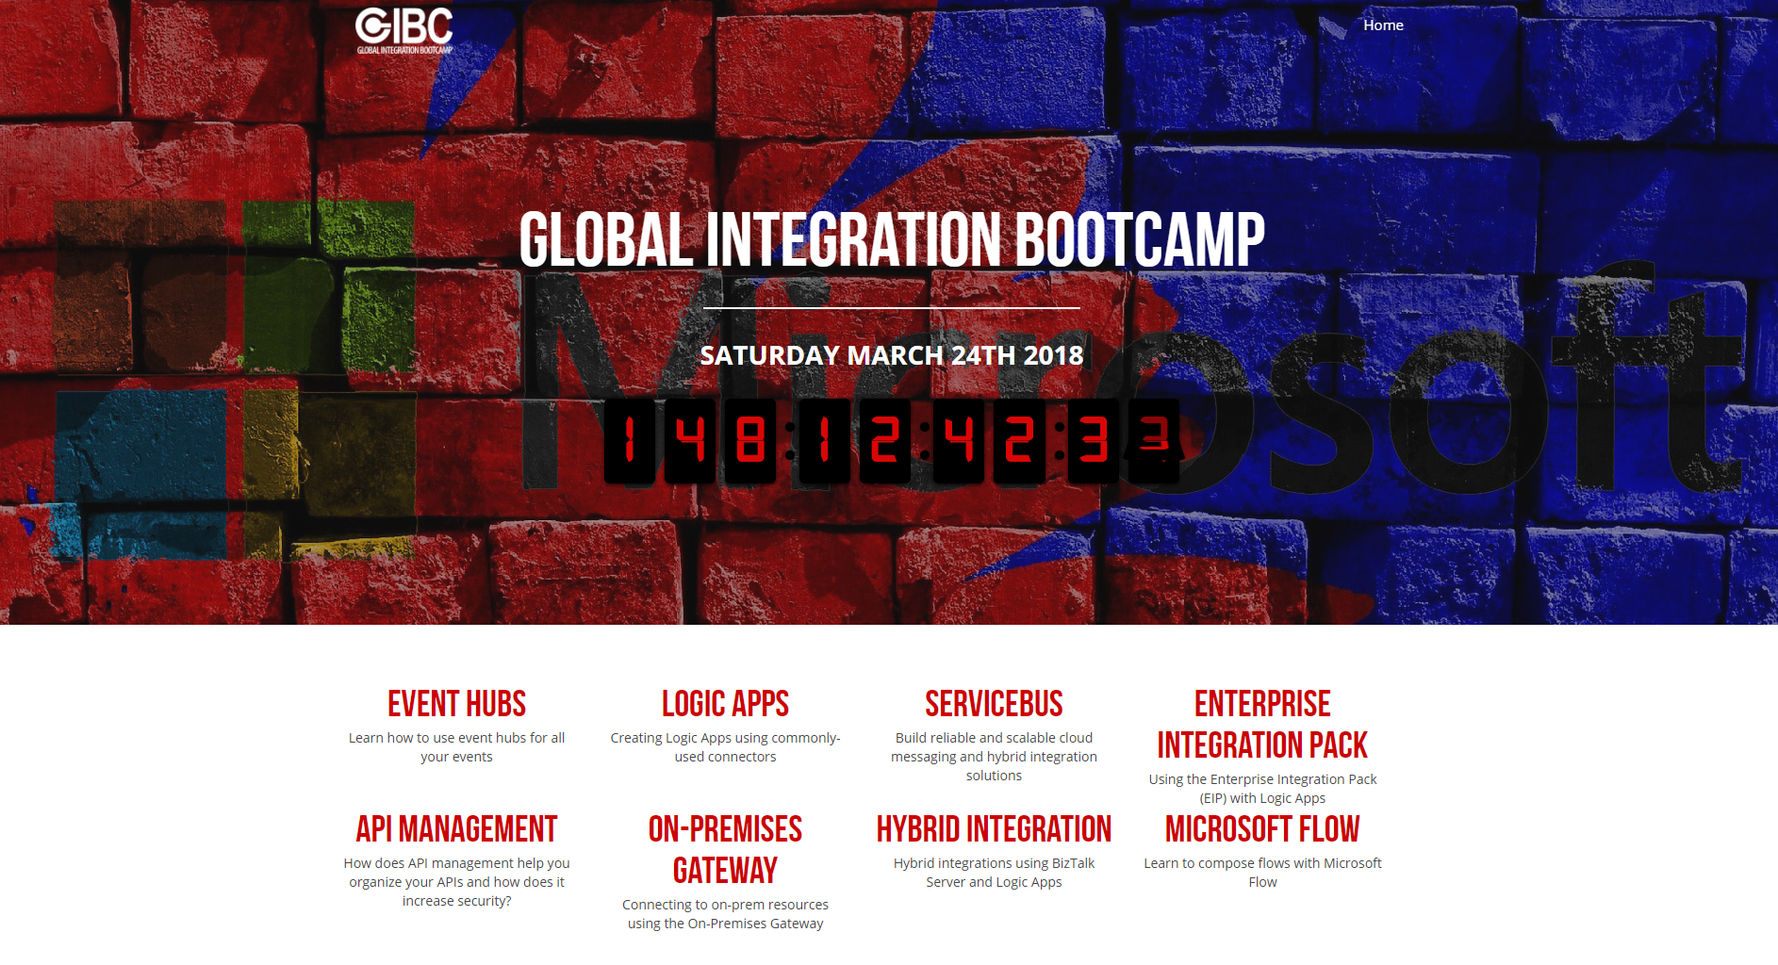


Slide 27





Thank You!
@egrootenboer
eldert.grootenboer@motion10.com
http://blog.eldert.net/
http://blogs.biztalk360.com

Slide 28




Think
Share
Move

